Slide 1


Slide 2

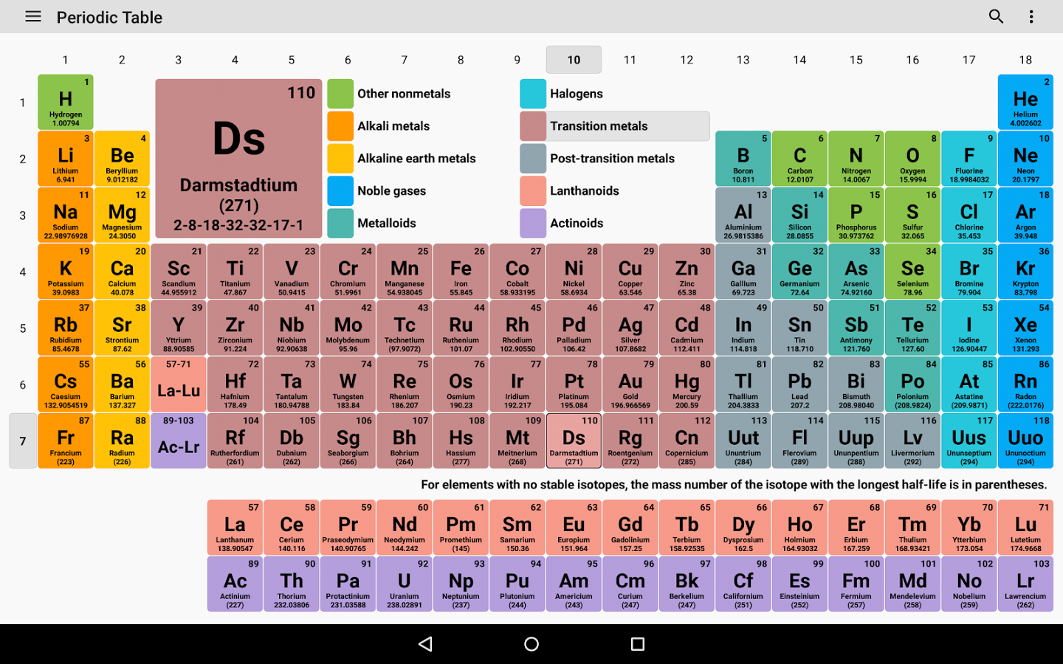
PERIODIC TABLE OF ELEMENTS (MENDELEEV TABLE)
Notes:
This is periodic table, also called the Mendeleev table after the Russian chemist who designed it. It is a large grid of all the discovered elements in the universe. Each element is placed in a location based on its atomic structure.

Slide 3
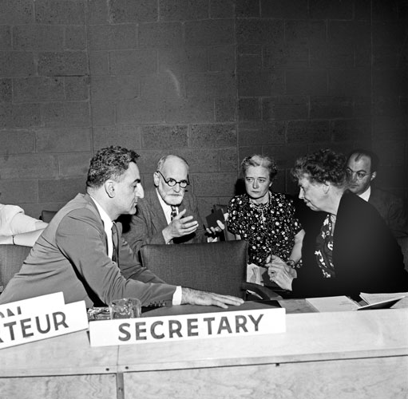
United Nations Universal Declaration of Human Rights, 1948
“All human beings are born free and equal in dignity and rights. They are endowed with reason and conscience and should act towards one another in a spirit of brotherhood.”
Notes:
This is article 1 of the UN Universal declaration of Human Rights, adopted December 10 1948. The photograph is the drafting committee at work.

